Slide 1
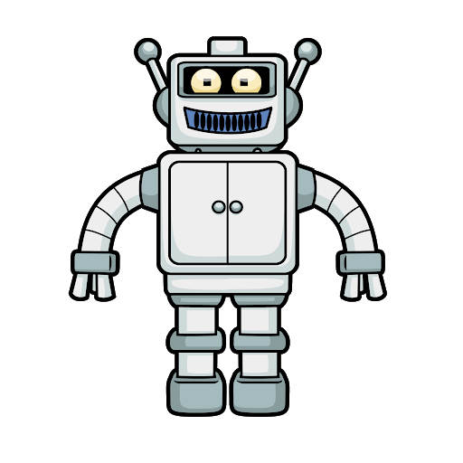
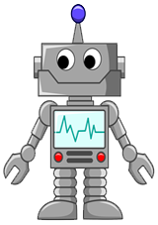
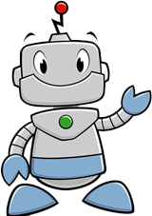
A companion robot for employees in a company to increase productivity by reducing their stress level
AS2016502
K. G. S. Sandaruwan
01/12

Slide 2

Occupations and environments
10 categories of occupations[1]
3 of them are more mental powered jobs rather than physical powered jobs
About half subcategories of those categories are indoor (table based) jobs
02/12

Slide 3

Working environment boredom[2]
Due to same and consistent environment[3]
Leads to reduce the productivity of the company
Most probably may happens for table-based employees due to mental discomfort[4]
03/12

Slide 4
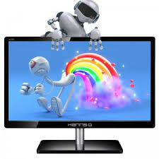
An Employee in an software development company
Most of time near a table with a computer
A companion robot, most of time may be like a toy on computer monitor
Can identify stress level, drowsiness, loneliness and such uncomfortable situations
Some actions to make the employee free of above uncomfortable things
04/12

Slide 5
An Employee in an software development company
If that change is powerful enough to distract employee from loneliness and consistency
If that change is not non-essentially huge to distract employee from their occupation related important things
Then such a robot may keep the employee happy and satisfied
And the productivity may raised automatically
05/12

Slide 6

Motivation
Personal experiences in software development environments
Passion to doing something new with robotics
06/12

Slide 7
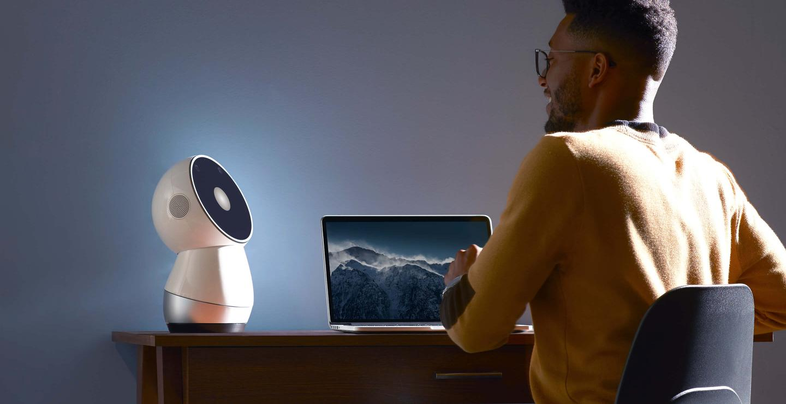
Current Developments (Companion Robots)
A robot creature for the purpose of real or apparent companionship for human beings
Jibo[5] from MIT, a most powerful companion robot for all kind of day-to-day applications
Seems like the best companion robot to refer as an example matching to the area of this project
07/12

Slide 8

Objectives
Make the working environment joyful from the employees’ perspective
Increase the productivity of employees and productivity of company from the employer’s perspective
Increase the non-physical (mental) health of employees from the company's HR’s perspective
08/12

Slide 9

Methodology
Design hardware part with available resources
Do the facial pattern analysis for detect mental discomfort situations such as drowsiness, loneliness etc...
Design mechanical movements which will not disturb employee, but only keep him/ her happy
Combine all things together as the final outcome
09/12

Slide 10
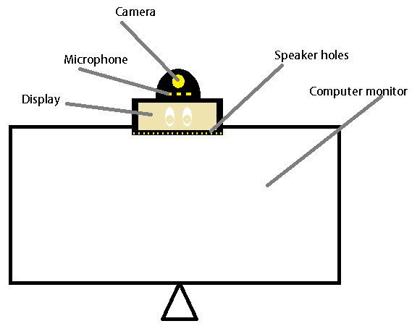
Design
10/12

Slide 11

References
https://en.wikipedia.org/wiki/International_Standard_Classification_of_Occupations#The_ISCO-08_structure
https://thepsychologist.bps.org.uk/volume-20/edition-2/boredom-work
https://www.psychologytoday.com/us/blog/science-choice/201706/eight-reasons-why-we-get-bored
https://timesofindia.indiatimes.com/life-style/health-fitness/health-news/why-you-feel-sleepy-at-work/articleshow/34249762.cm
https://jibo.com/
11/12

Slide 12
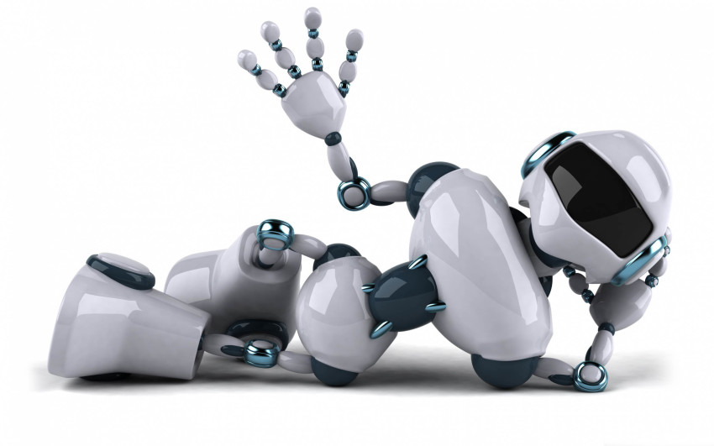
Thank you
12/12

